Slide 1

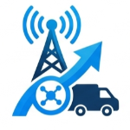





Introduction to ErcTrack (PFE)
PRESENTED BY
Reghioui Abdelrahim
Souheil Guellil Nazim Mohamed Guergadj Dellal Younes Zadi Abderraouf
May 23, 2026
University of Science and Technologies Houri Boumedian

Slide 2





Introduction to ErcTrack Project
ErcTrack is an innovative solution designed to address the critical issue of package and missions tracking in logistics. Ericsson faces significant challenges in tracking its equipment , leading to wasting time and resources . This presentation will outline the project's objectives, the technology behind it, and its potential impact on the logistics industry. Join us as we explore how ErcTrack can revolutionize package tracking and enhance operational efficiency.

Slide 3



Identifying Core Issues
Challenges in Tracking
Visibility and Delays
Many companies and Ericsson is one of them struggle with tracking packages, leading to significant operational challenges and inefficiencies that hinder overall productivity .
A lack of visibility in package tracking results in delayed deliveries, which can lead to a negative impact on repeat business and brand loyalty.
Financial Implications
Inefficient tracking methods can cause financial losses, with studies showing that companies can lose a lot of revenue due to delivery errors and delays.

Slide 4

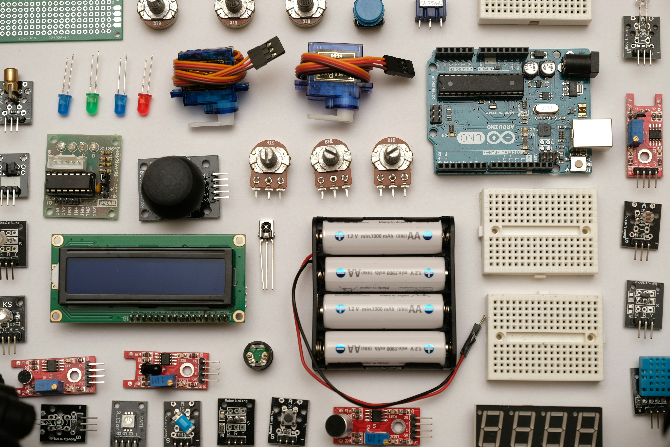

Possible Solutions
AI\camera based solution
IoT-Based Solutions
Network-Based Systems
by install cameras in the delivery path but it is so expensive to be applied
By attaching a tracking device in package and track it
by tracking location of the driver's phone

Slide 5
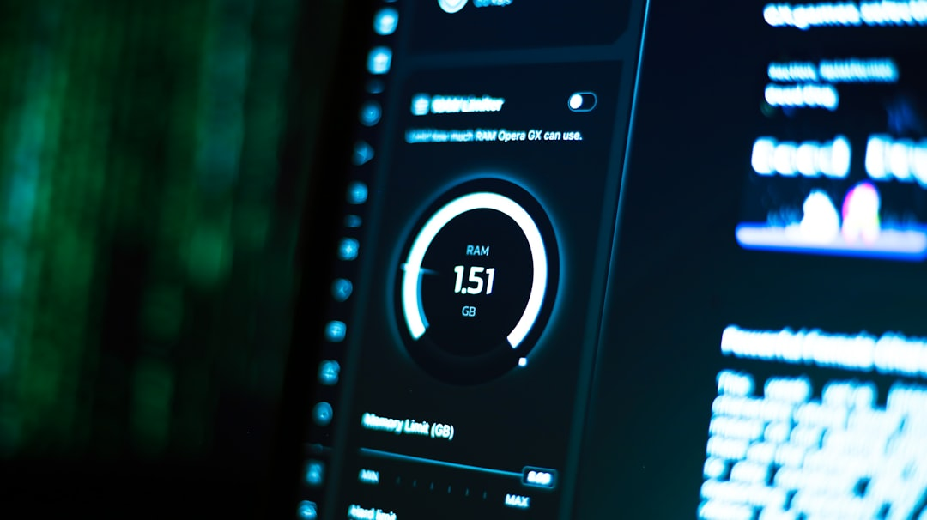
Why We Chose IoT
Real-Time Tracking Independent from user behaviors Coast reduction Better operational efficiency Faster problem detection Improved accuracy

Slide 6


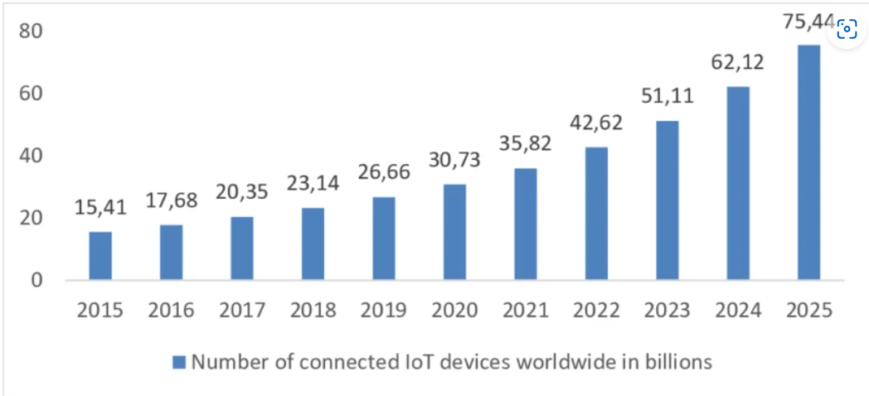
Reliability and Efficiency of IoT

Slide 7
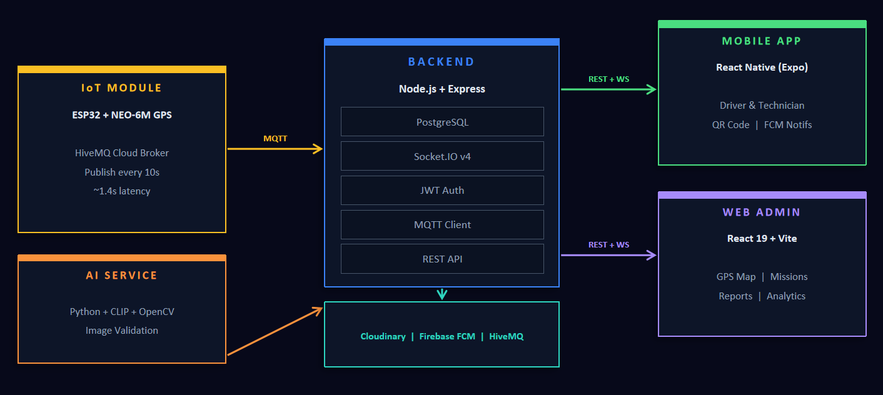
ErcTrack Architecture Overview

Slide 8
Mobile App Features
Driver Interface
Technician Interface
View assigned missions & details
View mission details & site info
Scan QR code to initiate delivery
Scan QR code to confirm delivery
Real-time GPS route (Leaflet map)
Submit field intervention report
Push notifications (Firebase FCM)
Upload site photos (AI-validated)
KEY PERMISSIONS
KEY PERMISSIONS
Report incidents during transit
View past interventions history
Location
Camera
Notifications
Camera
Storage
Location

Slide 9


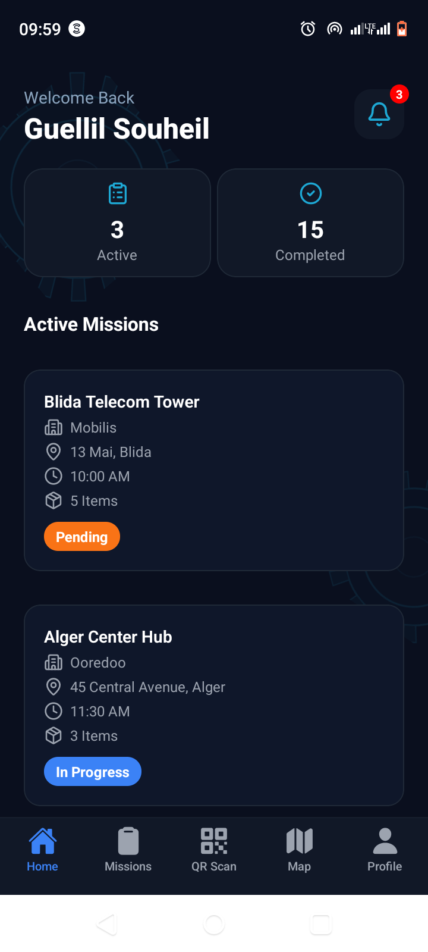
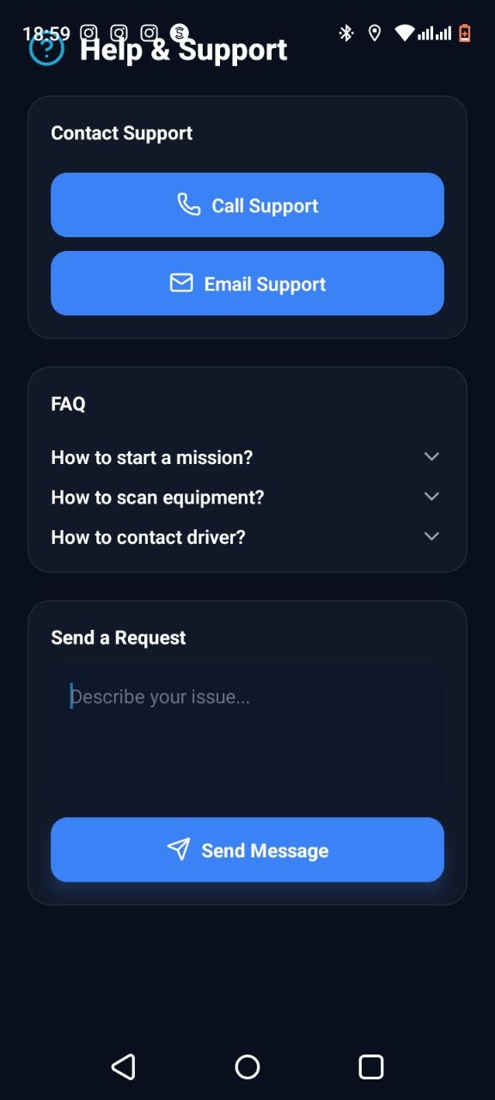

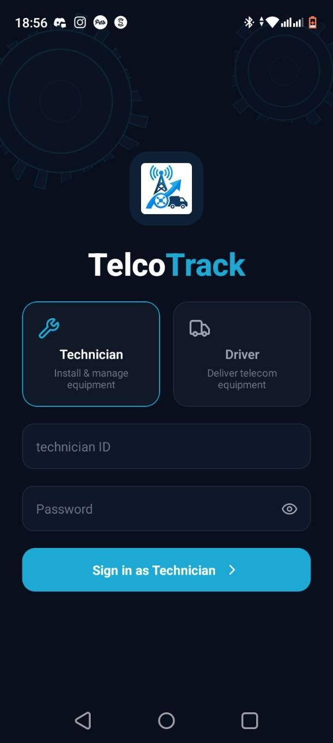
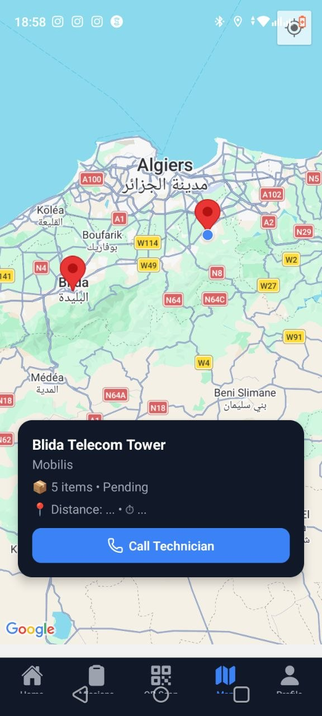

Some Pictures of the mobile app

Slide 10

Web App Features
KPIs & Analytics
Live GPS Map
Mission Management
Active missions, deployed equipment, field technicians, critical alerts in real time.
Leaflet.js map with real-time markers. Triple strategy: Socket.IO + 5s polling fallback.
JSON import, assignment to driver/technician, status tracking end-to-end.
Report Validation
Team Management
Live Notifications
Review field reports, approve or reject with admin comments and audit trail.
Full CRUD for drivers & technicians, mission history, contact info.
Real-time alerts for missions, GPS events, reports — click to navigate directly.

Slide 11
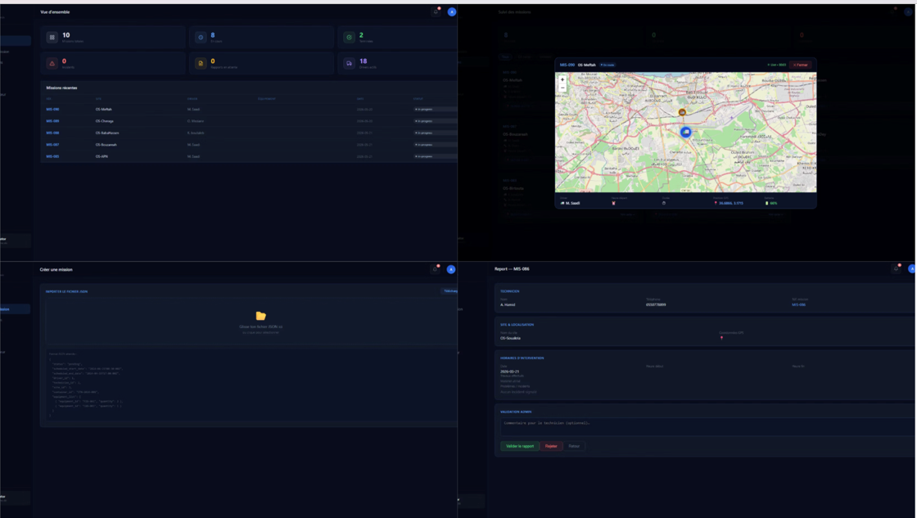
Some Pictures of the Website

Slide 12
AI Image Validation — CLIP + OpenCV
Python microservice validates every photo before storage in Cloudinary.
01
02
03
Blur Detection
Brightness Check
Content Relevance
Laplacian Variance (OpenCV)
HSV Analysis (OpenCV)
CLIP Model (OpenAI)
If fails → REJECTED
If fails → REJECTED
If fails → REJECTED
VALID → Upload Cloudinary CDN
INVALID → Rejected + User notified

Slide 13
Real-Time GPS Tracking — End-to-End Flow
ESP32
HiveMQ
Backend
Socket.IO
Leaflet Map
NEO-6M GPS
Cloud Broker
Node.js
WebSocket
Web Admin
Reads lat/lng
MQTT relay
Processes data
Broadcasts live
Updates marker
MQTT
WS Event
Emit
Subscribe
TRIPLE RELIABILITY STRATEGY
Strategy 1 — Primary
Strategy 2 — Backup
Strategy 3 — Fallback
Socket.IO WebSocket (instant, real-time)
GPS polling via REST API every 5 seconds
Mission status polling every 5 seconds

Slide 14
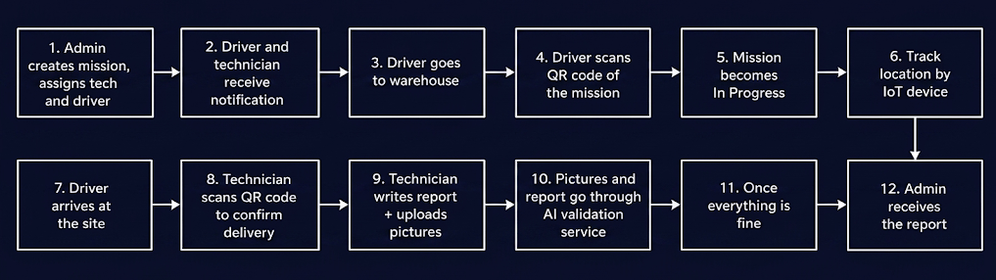
ErcTrack Application Workflow

Slide 15
Conclusion
ErcTrack's Impact
IoT Advantages
ErcTrack effectively addresses critical package tracking challenges, enhancing visibility and accountability in logistics, which is vital for modern supply chain management.
The IoT solution provides significant reliability and efficiency, reducing tracking errors and improving delivery times , leading to better resource management.
Comprehensive System
Our system integrates a mobile app, web dashboard, iot AI services , ensuring seamless user experience and real-time data access for improved decision-making.

Slide 16





Key Takeaways
In conclusion, ErcTrack offers a robust solution to package tracking challenges through IoT technology, enhancing reliability and efficiency. Key features include real-time tracking, user-friendly mobile and web applications, and AI integration. Moving forward, we recommend further testing and user feedback to refine the system, ensuring it meets evolving needs. Together, we can revolutionize package tracking and improve logistics operations significantly.

